Slide 1
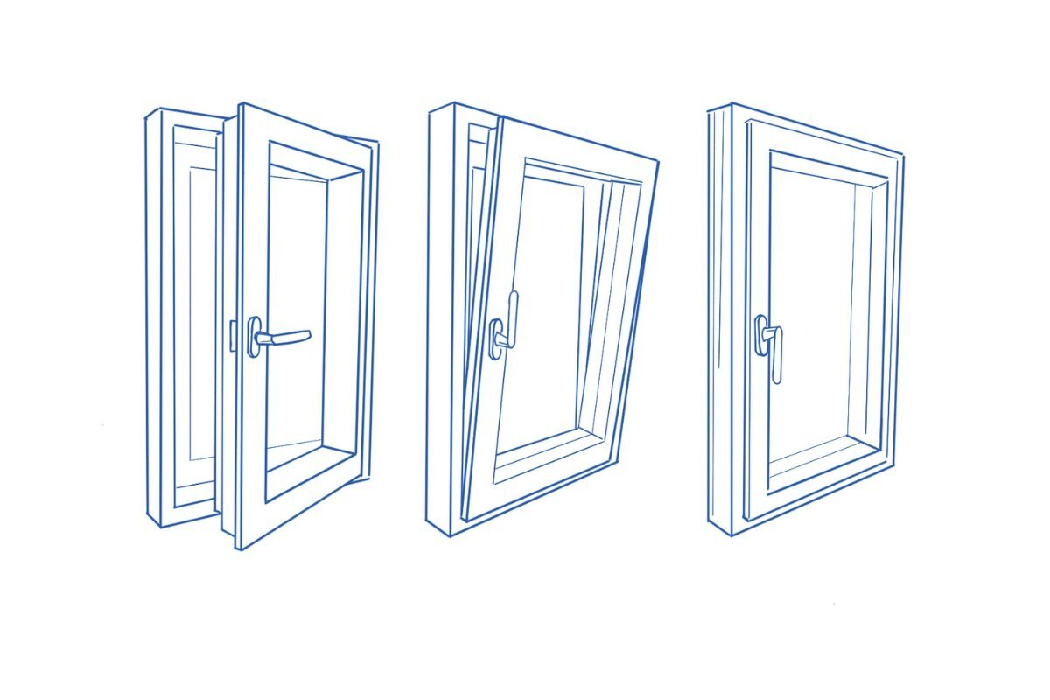
LUFTA
Better Air – Better Sleep

Slide 2
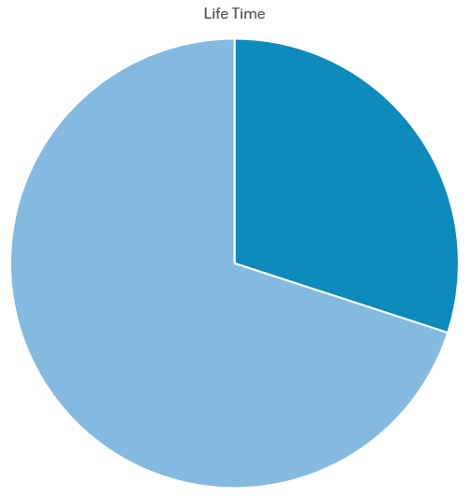
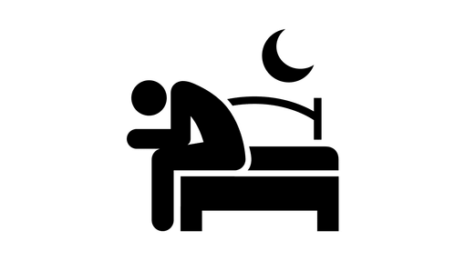



Introduction
WHO Air Pollution
Outdoor Air Quality ~3x over the limit
99% of people breath it
Millions of death per year
Let’s not make our indoor air worse
Air Property | Effect
High Co2 | Less restful, More awakenings
High Humidity | Temperatur feels warmer, Mold danger
Low Oxygen | Reduced brain function
High Dust/Others | Developing allergies, More infections
Notes:
Sleep is 1/3 of our lifes
High Co2/Humidity and Low Oxygen means worse sleep
WHO Air Pollution: https://www.who.int/news-room/fact-sheets/detail/household-air-pollution-and-health

Slide 3
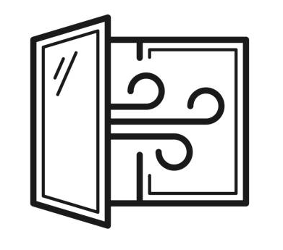


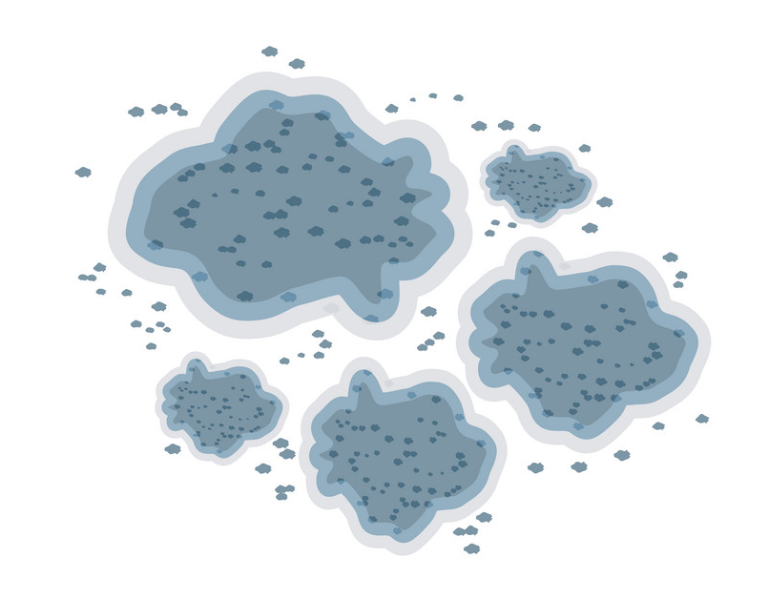

Problems
Notes:
Co2 and Sleep: https://blog.fitbit.com/sleep-with-fresh-air/

Slide 4
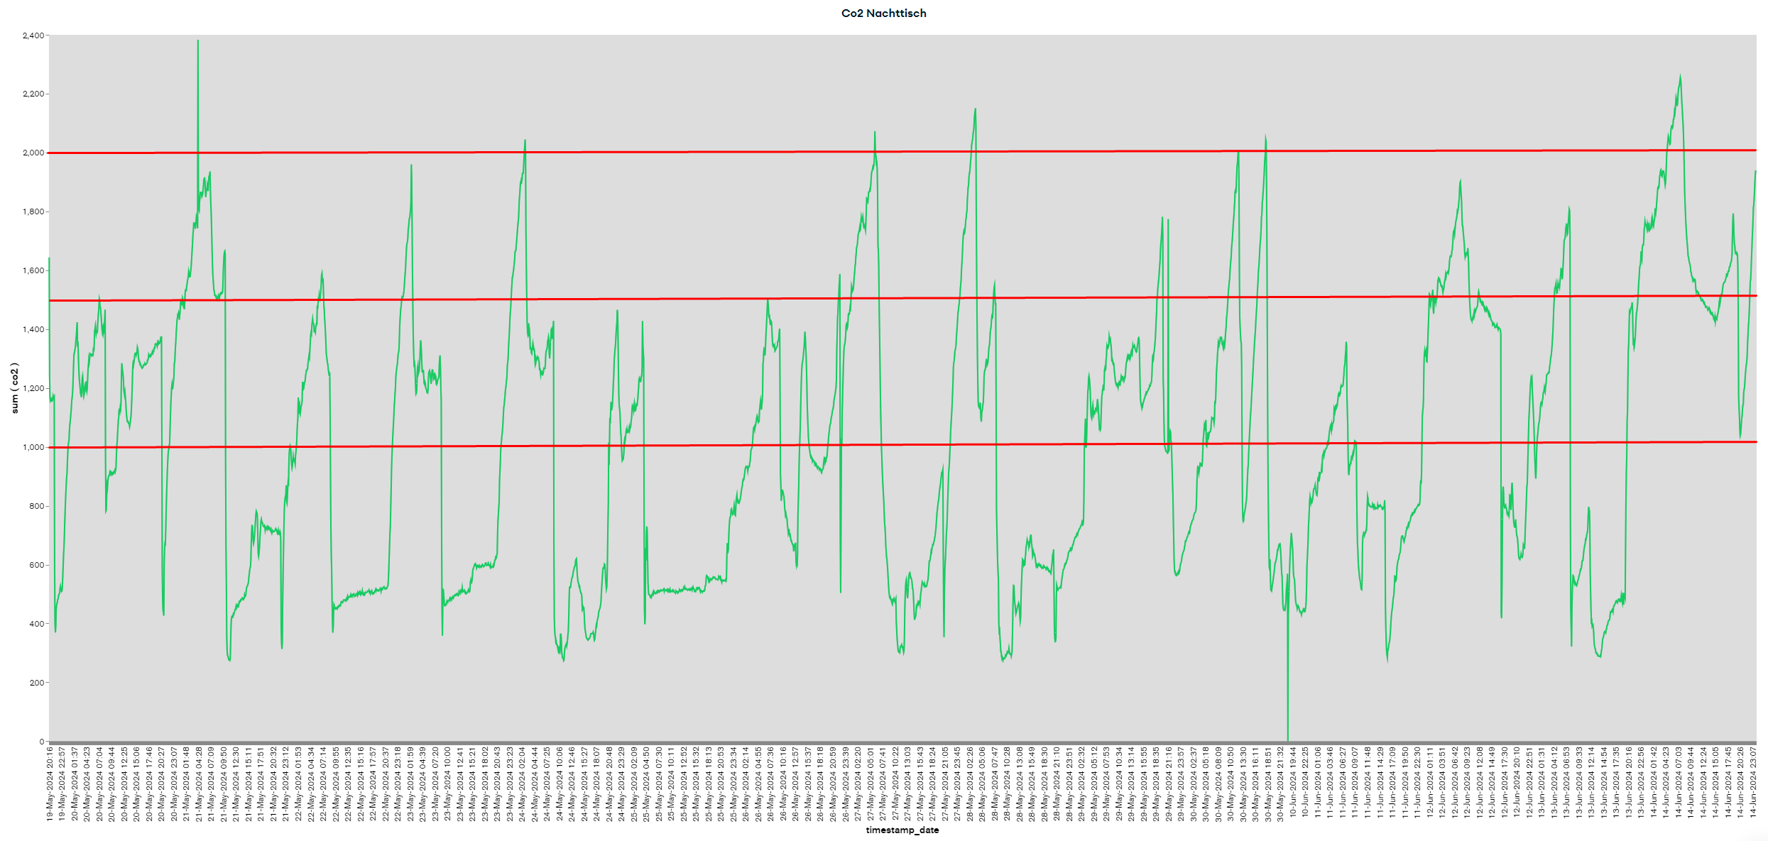
DateRange: 19.05.24 – 15.06.24
+2000 (1.5%)
+1500 (17%)
+1000 (50%)
Recommended: 400 – 1000 ppm

Slide 5
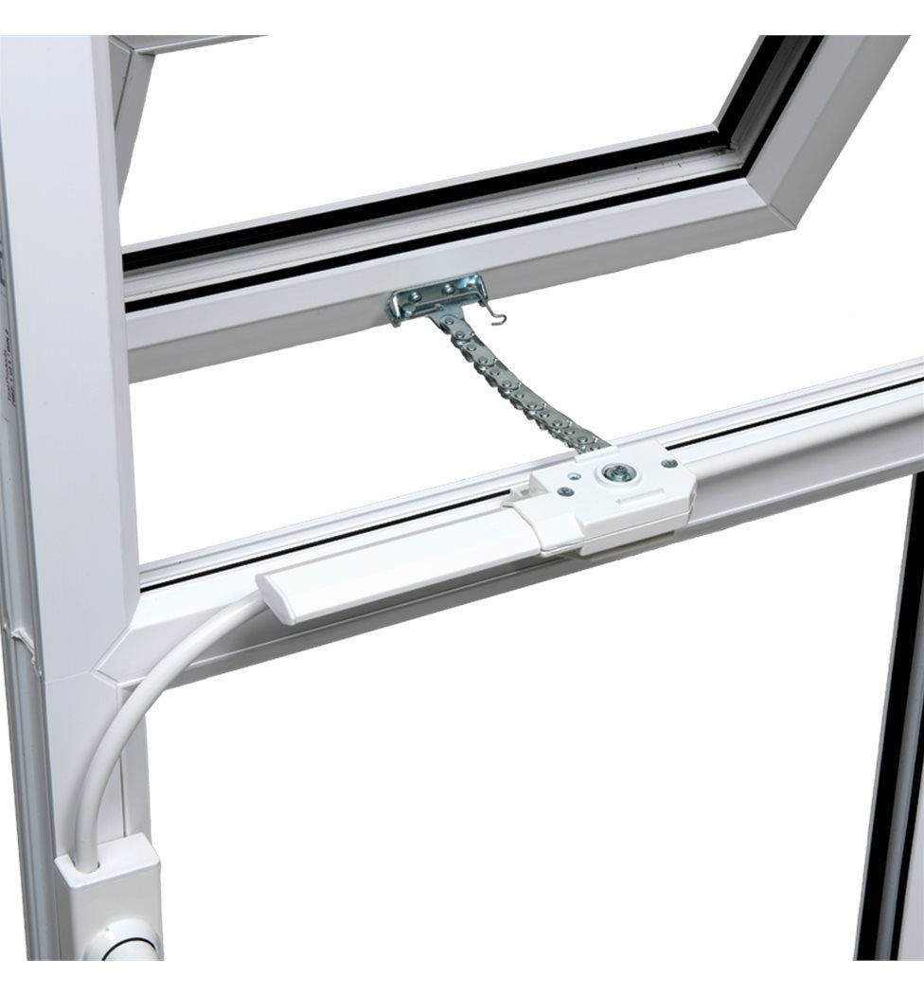
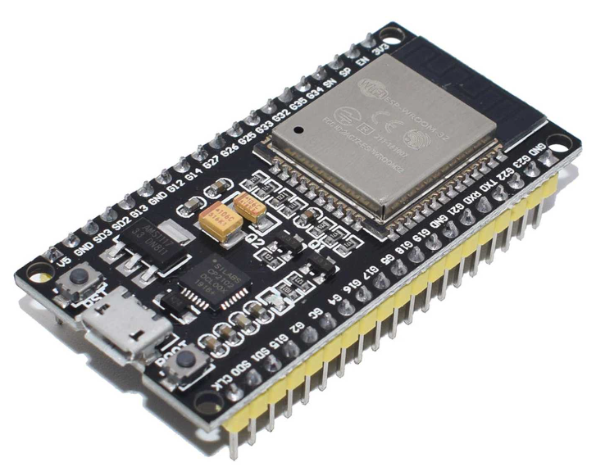
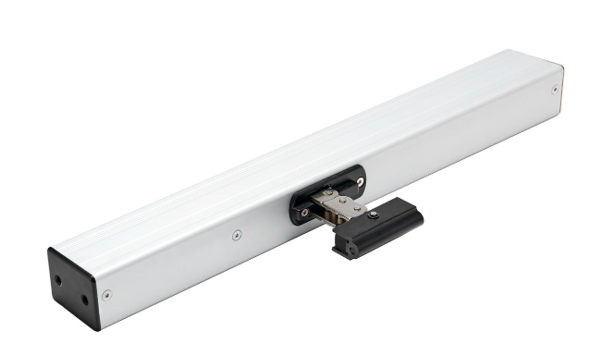

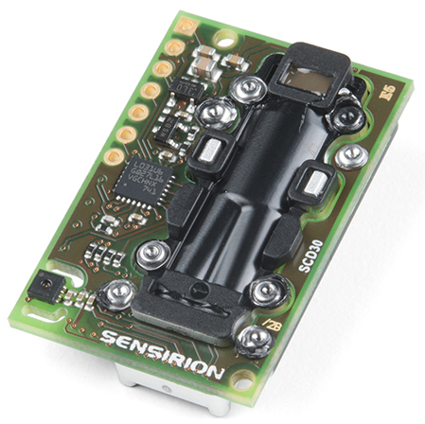
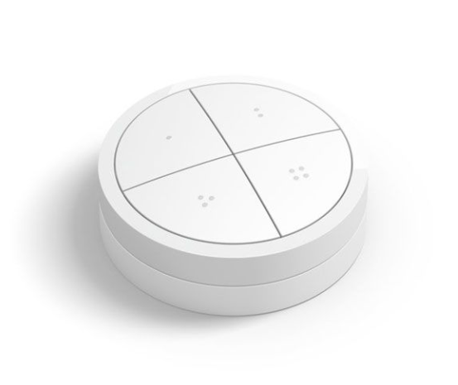
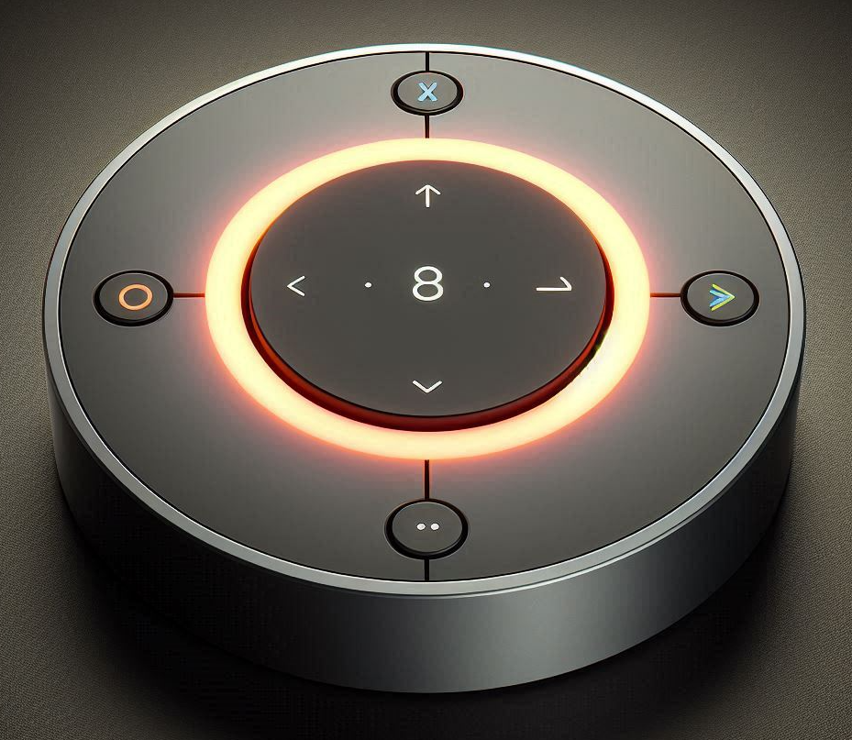
Solution

Slide 6
Basic Features
All-In-One Set
  Not available as standalong set
Simple Mounting
  No drilling into window frame (renters)
No Noise/Light Emmissions
  Eliminate other reasons to wake up
Manual Control
  For more control

Slide 7
Extensions
Data Collection
  Valuable for studies or other companies
Wake Up Timer
  Wake up with fresh air
No Open Times
  Pollen in the air or trains diving by
Home Integration
  Trigger other automations and control
Smart Air Flow (2+ Window Openers)
  Optimize air flow between openers to reduce open times
Different Mounting Options
  Wireless Charging Base, Magnetic Wall Mount
Rain Detector
  Close the window to avoid rain entering room
Mold Prevention Reports
  Useful for insurances and evidence towards landlord

Slide 8
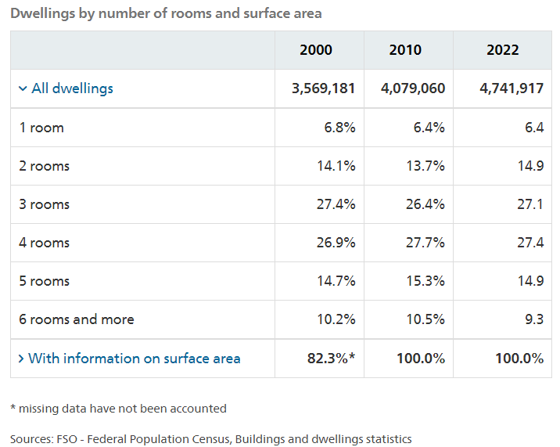
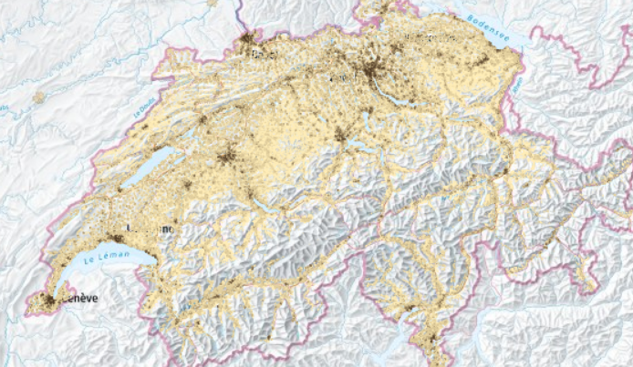
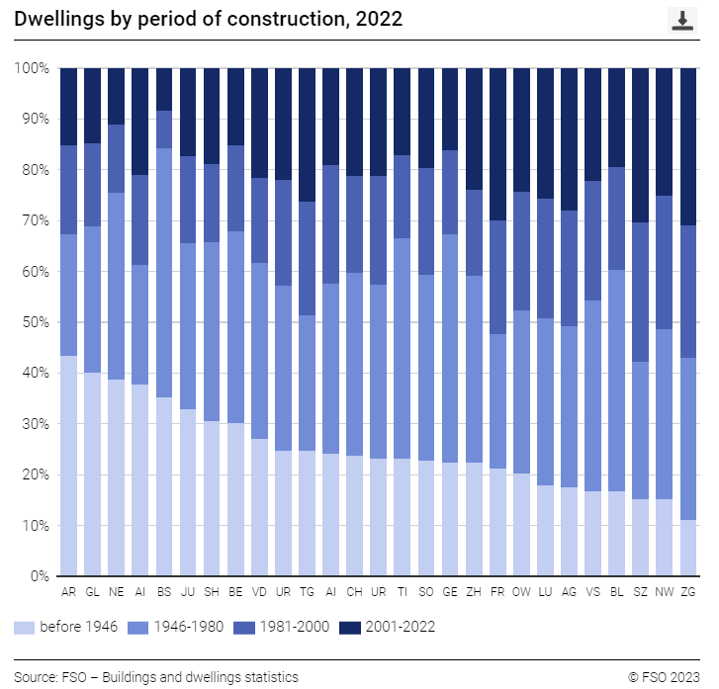
Switzerland has over 4.7 million housing units as of 2022, and most of these were built before the year 2000.
Market Impact of Window-Based Product Usage:
4.4 Million Potential, with 235,000 pcs Annual Sales at 10% Market Share in five years possible.

Slide 9
Market Switzerland
Total Population - 8 Mio.
Total Bedrooms - 4 Mio.
Target Market 10% - 400’000
Product Price - 500 CHF
Total Market - 2 Mrd. CHF
Target Market - 200 Mio. CHF
Accessible Market (5J) - 10 Mio. CHF (5% vom Zielmarkt)
Annual Goal - 400’000 CHF

Slide 10





Companies in the market
IAQ Solution | Automated Window
No | No | https://www.smartwindows.ch/produkte.html
No | No | https://view.com/product
Yes Mobile app | Yes | https://www.smartfenestra.com/products USA
Yes Mobile app | Yes | https://www.getawair.com/products/element
Yes | Yes | https://www.windowo.com/blog/electric-window-opening-how-does-it-work- ITALY

Slide 11





Companies in the market
IAQ Solution | Automated /Electric Window
Yes | Yes | https://www.geze.sg/en/products-solutions/windows/c_36786
No | No | https://www.automatikfenster.ch/en/windschutz-2
Yes Mobile app | Yes | https://www.velux.ch/de-ch/produkte/dachfenster/solar-elektro-schwingfluegelfenster
No Mobile app | Yes | https://shop.somfy.co.uk/products/smart-home/
No Mobile App | Yes | https://www.dormakaba.com/ch-en

Slide 12






Companies in the market
IAQ Solution | Automated /Electric Window
No Mobile App | Yes | https://www.assaabloy.com/group/en/news-media/stories/access-stories/yale-aeron
Tool zur Bemessung der natürlichen Lüftung |  | https://www.windowmaster.ch/hilfsmittel/berechnungstools/tool-zur-bemessung-der-naturlichen-luftung/metrisch/?_gl=1*14w15fw*_up*MQ..&gclid=CjwKCAjw88yxBhBWEiwA7cm6pSbygX1IUFCWDaeGNjEm1iZxGOJ3ZDATbUC9564yGete-GiJuHP1IxoCOP4QAvD_BwE
No Mobile App | Yes | https://shop.fakro.at/fernbedienung-zrh12.html
No Mobile App | Yes | https://faac.ch/produkte/automationen-fuer-besondere-eingaenge/catalog/airslide-doors/
No | No (?) | https://aluprof.com/aluprof-theme/images/logo.svg?v=1714643429

Slide 13
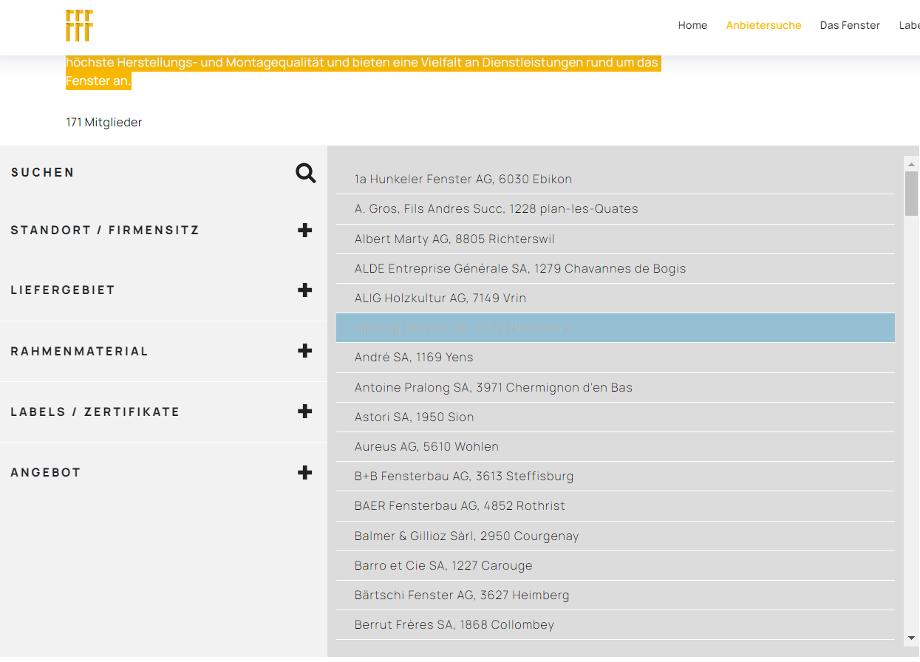
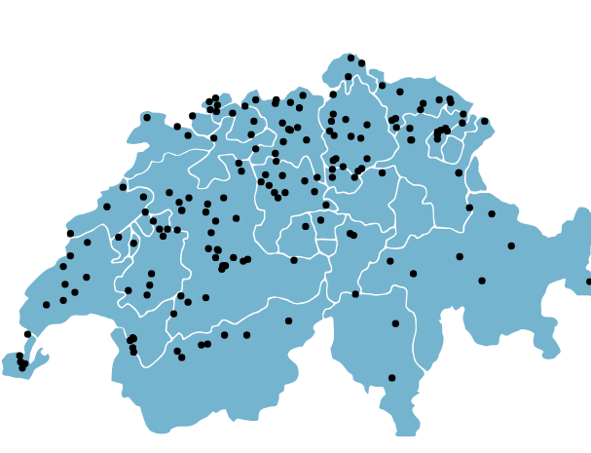
FFF – Schweizerischen Fachverband Fenster- und Fassadenbranche (171 members)

Slide 14









Businessmodel
Products
Company
FFF
Ideall Engineering GmbH
Money / Data
Client
Private Person
Companies
Goverment
Schools
Employees
Freelancer

Slide 15

Investment Needs

Slide 16
Schlusswort

